Slide 1
Basic Cross-Platform Application Programming With .NET

Slide 2
Why should you study this course?
How to develop a Cross-platform .NET applications?
How to develop a .NET application supporting some functions concurrently?
How to develop .NET applications using GUI (Graphical User Interface)?
How to apply Design Pattern in .NET applications?

Slide 3
Why should you study this course?
How to develop .NET distributed applications?
How to develop .NET database applications?
How to develop ASP.NET MVC Core applications?
Do you want to earn Certifications from Microsoft?
https://docs.microsoft.com/en-us/learn/certifications/

Slide 4
Prerequisites
Completed:
PRO192-Object-Oriented Programming
DBI201-Database Systems

Slide 5
Course Objectives
Developing multi-threading .NET Applications
Building GUI applications using Windows Forms
Building Website using ASP.NET MVC Core
Using Design Pattern in C#
Connecting with Database using ADO.NET and Entity Framework
Building client-server applications with ASP.NET Web API by Windows Forms and ASP.NET MVC Core

Slide 6
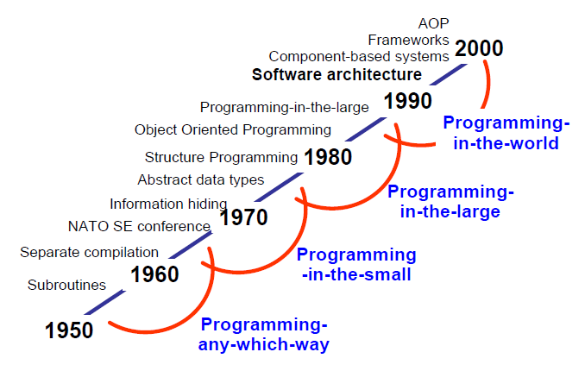
Evolution of Software Design

Slide 7
Course Description
OOP and C#
Concurrency
Design Pattern in .NET
Creating a GUI using Windows Forms
Creating a ASP.NET MVC Core application
Database Access by ADO.NET and Entity Framework Core
Assemblies .NET
Files and Streams I/O
Working with ASP.NET Web API

Slide 8
Course Plan
See course plan on CMS

Slide 9
Materials/ References
1) Pro C# 9 with .NET 5
ISBN: 978-1-4842-6939-8
2) https://docs.microsoft.com/en-us/dotnet/core/introduction
3) CMS forums

Slide 10
Learning Environments
.NET 5 or later
Visual Studio 2019 or later (https://visualstudio.microsoft.com/downloads/)
MS SQL Server 2014 or later
A Notebook for reports of labs and assignments.

Slide 11
Course Rules
How to conduct
Prepare contents of the next session at home
Following lessons in classroom
Completing chapter assessments in time and Quizzes (via CMS)
Write reports of all labs and assignments to your notebook
Communication
Class
Interchange by FU-HCM CMS, Forum
Discussing actively in your team and classroom
Free to question and answer
Others
Off phone, no game, no chat in class
Use laptop under teacher’s instruction

Slide 12
Evaluation Strategy
Must attend more than 80% of contact hours (if not, not allow to take exam).
Evaluating
02 Progress Tests (PT, 10%)
03 Assignments (AS, 10%)
01 Practical Exam (PE, 25%)
(Practical exam retake only when the score of PE < 4))
01 Group Project(GP, 25%)
Final Exam (FE, 30%)
Total score=10%(PT)+10%(AS)+25%(PE)+25%(GR)+30% (FE)
Pass:
Every on-going assessment component >0 and
Practical Exam >=4 and
Final Exam Score >=4 and
Final Result >=5
Final exam retake only when not passed

Slide 13
How to study
This course is complex knowledge (however, it’s attractive and exciting), so you need to keep a tight grip on it
Read
On the books to get the general concept
Reference, study, collection from anywhere else (internet, your classmate, forum …)
Attend lectures
Listen, understand, then make your notes
Give your explanation about some topic in lectures
Ask questions
Give some examples that do not exist in your book
Practice all the exercises, demo to make your sense
After classes
Discuss your classmate indirectly, on the forum
Analyze, design, and implement workshops and assignments. Write reports in your notebook
Build your team in yourselves to support together in studying

Slide 14
Academic policy
Cheating, plagiarism and breach of copyright are serious offenses under this Policy.
Cheating
Cheating during a test or exam is construed as talking, peeking at another student’s paper or any other clandestine method of transmitting information.
Plagiarism
Plagiarism is using the work of others without citing it; that is, holding the work of others out as your own work.
Breach of Copyright
If you photocopy a textbook without the copyright holder's permission, you violate copyright law.

Slide 15
Enjoy the Course
Be enthusiastic about the material because it is interesting, usefull and an important part of your training as a software engineer.
Our job is to help you learn and enjoy the experience.
We will do our best but we need your help.
So let’s all have fun together with C# Application Development!!!

Slide 16
Install tools for programming if needed
Q&A

